Slide 1


Project - Power Plant Energy Production
Final Presentation Group 2

Slide 2

Business Objective
A combined-cycle power plant comprises gas turbines, steam turbines, and heat recovery steam generators. In this type of plant, the electricity is generated by gas and steam turbines combined in one cycle. Then, it is transferred from one turbine to another.

Slide 3

Goal
We have to model the energy generated as a function of exhaust vacuum and ambient variables and use that model to improve the plant's performance.

Slide 4
Methodology
1 : EDA
2 : Feature selection
3 : Data Splitting
4 : Model Building
5 : Data Analysis
6 : Comparison of Regressors
7 : Selecting Best Model

Slide 5

Exploratory Data Analysis
The main purpose of exploratory data analysis is to readily get some idea about the entire data and draw instant conclusion from power plant energy production ,
Total number of observation are 9568 .
After data cleaning we are left with 9527 observation.

Slide 6
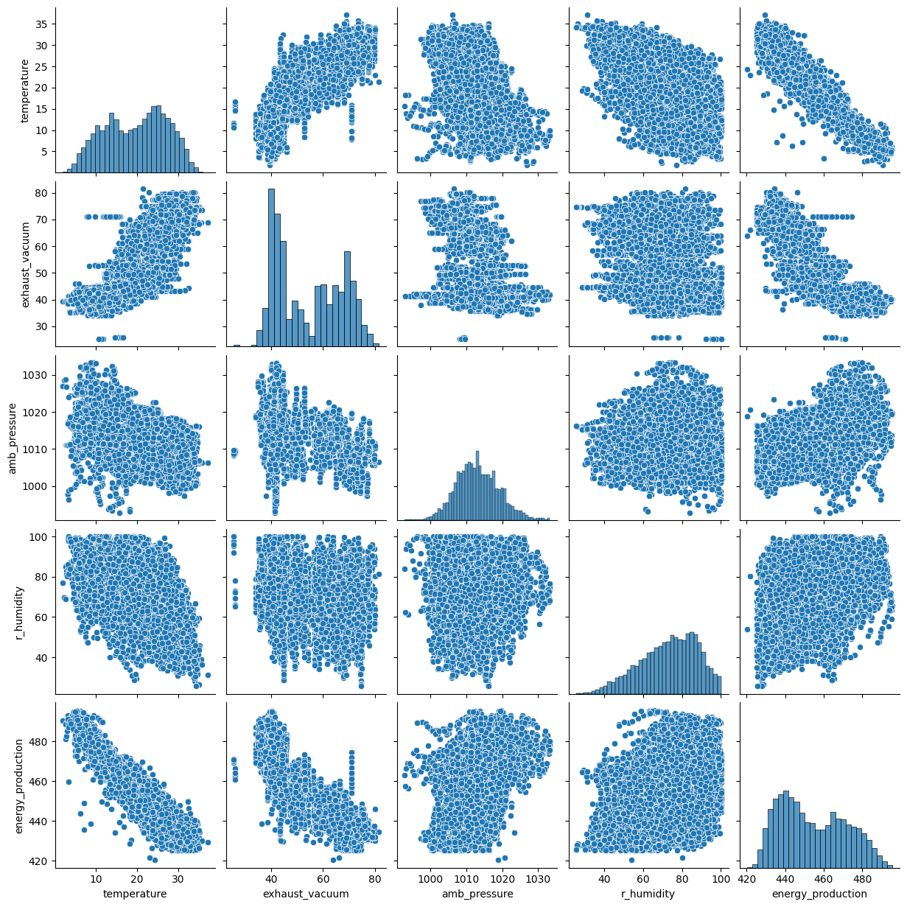
Given pair plot shows relationships between variables and distribution in our dataset.
It shows joined distribution and marginal distribution . Joined distribution are scatter plot and marginal distribution are histogram
When there is a clear upward or downward trend in the scatterplot, it indicates a strong positive or negative correlation between the variables.

Slide 7
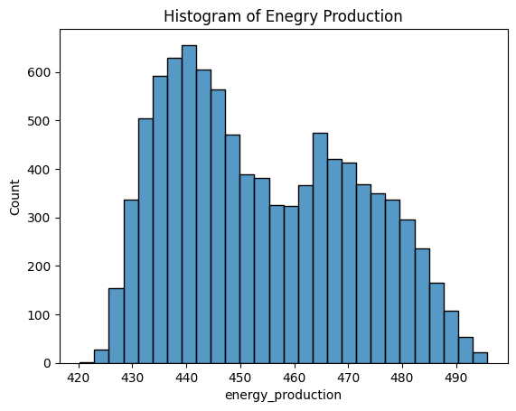
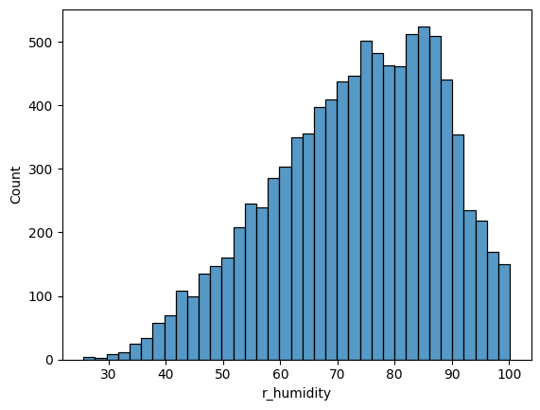
It shows the count of highest energy_production which is above 600.And it can be spread out more on right . It is said to be negatively skewed.
It shows the count of highest r_humidity which is above 500.And it can be spread out more on left . It is said to be positively skewed.

Slide 8
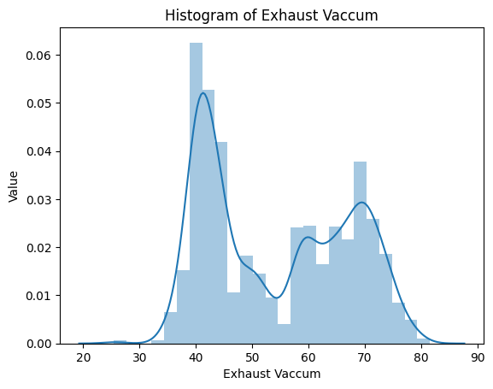
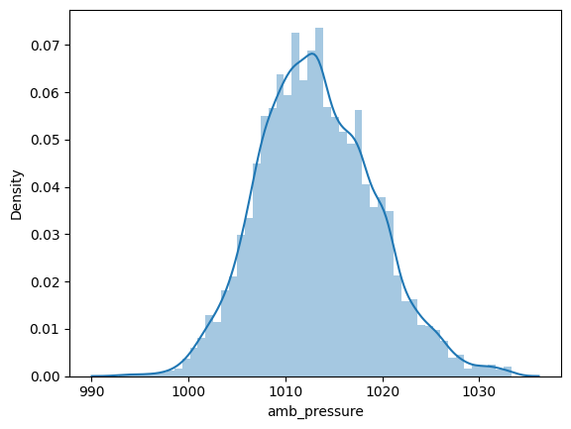
This histogram shows the values of exhaust vaccum.
From histogram we can say that density is almost normally distributed.

Slide 9
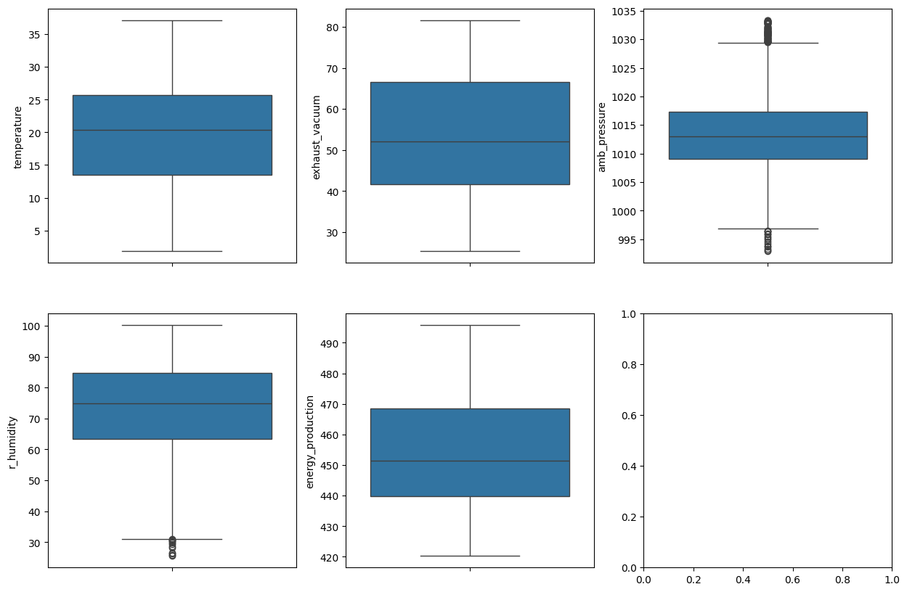
Outliers
We used boxplot to detect the outliers.
Boxplot shows that amb_pressure and r_humidity have outliers.
To remove outliers we used IQR and cook’s method.

Slide 10
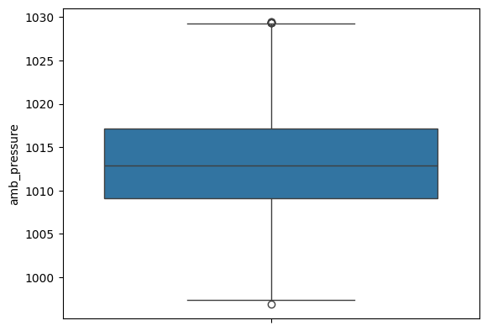
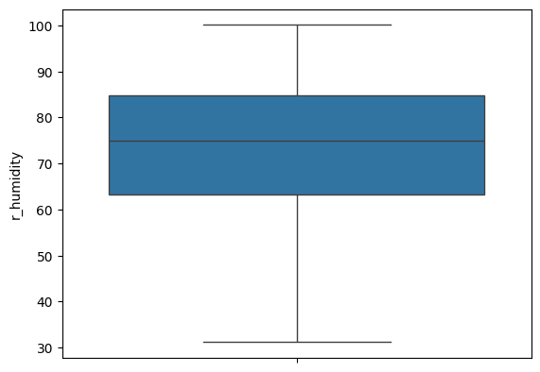
After removing the outliers using IQR and COOK’s distance

Slide 11
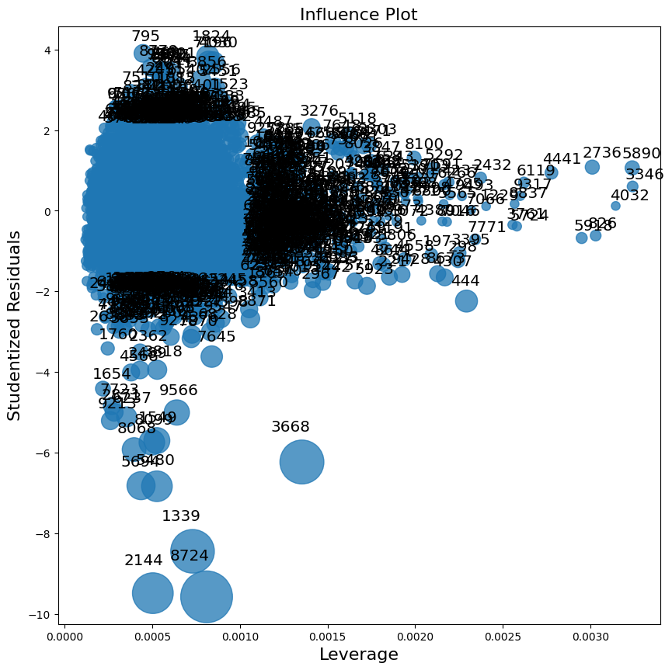
Influence Plot
Using cook’s distance method we check the influence points.
Cook’s Distances can be 0 or higher. The higher the value, the more influential the observation is.
leverage_cutoff = (3*(k+1))/n
Cutoff line at 0.002

Slide 12
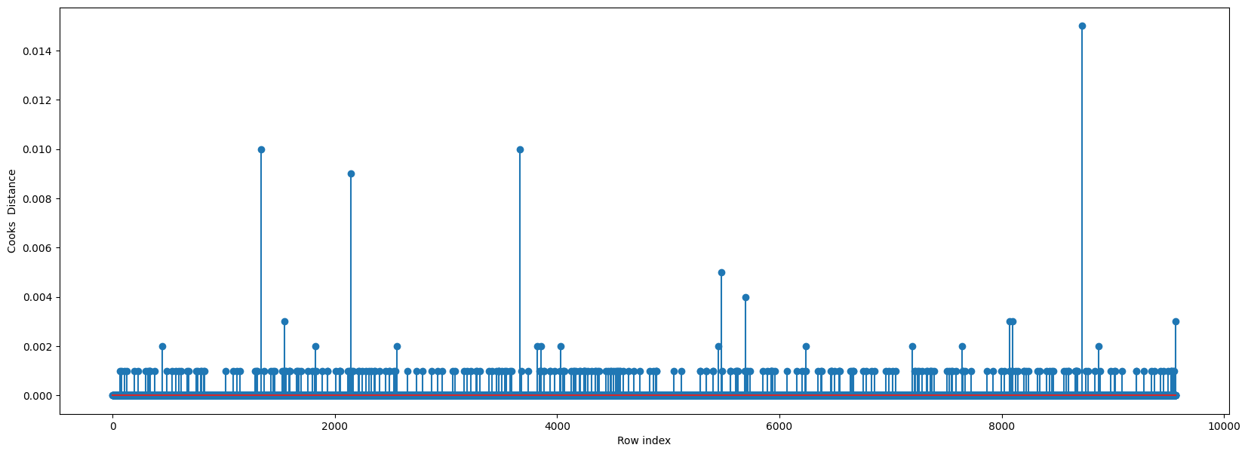
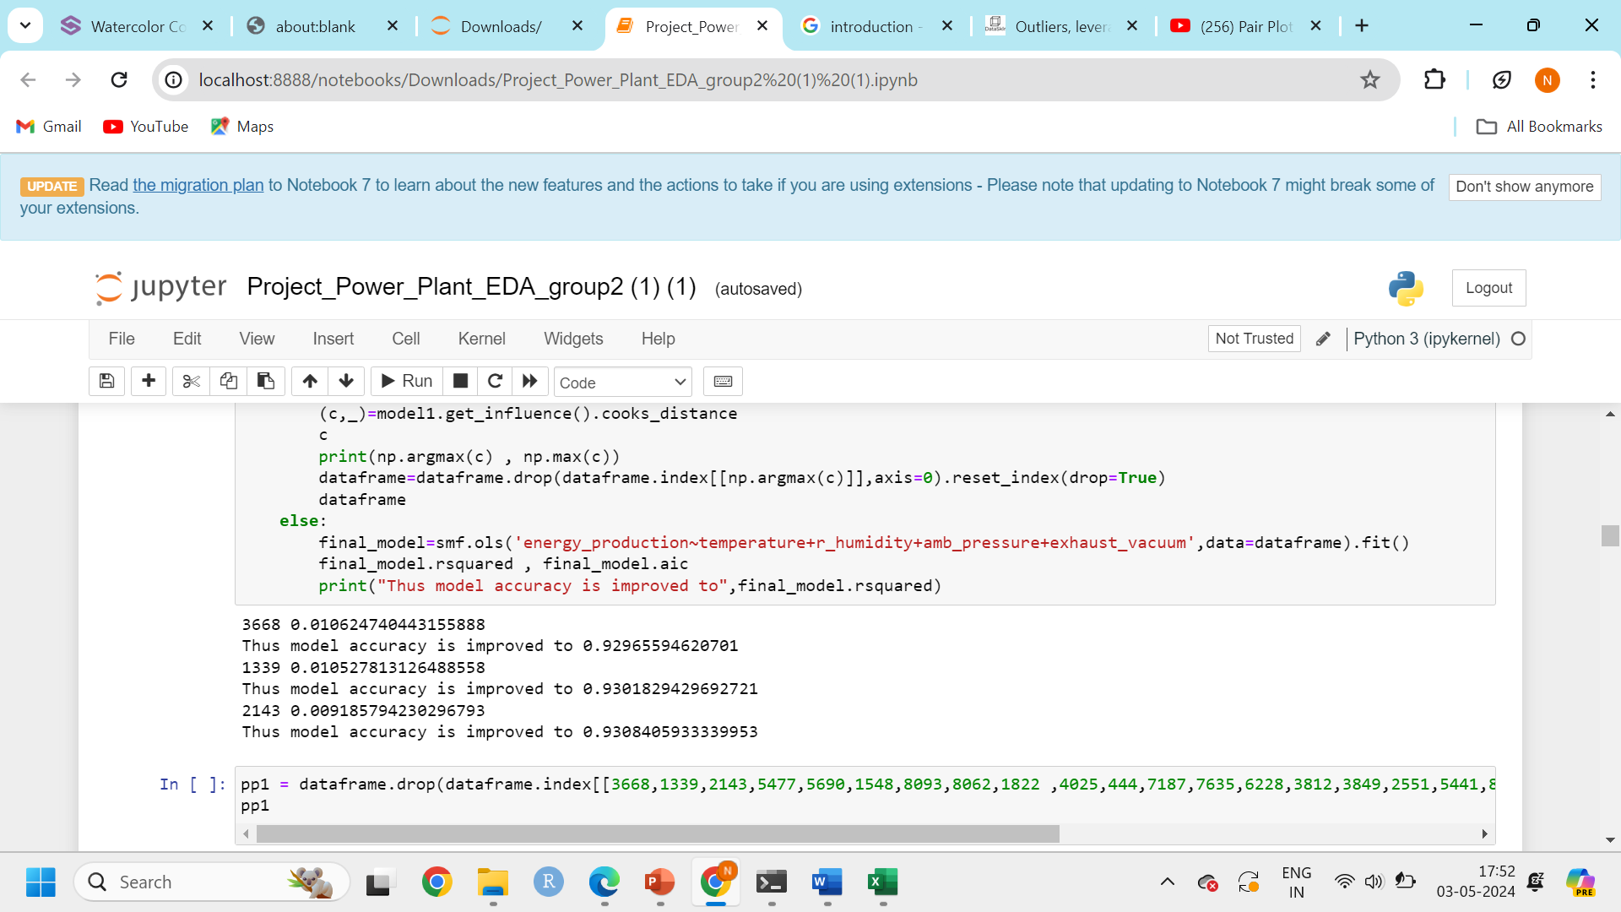
We further plot the influence values using stem plot . And find out the accuracy rate of our model.

Slide 13
Feature Selection
In order to improve the performance of the model and reduce the computational cost, only selected attributes of the samples act as features. Filter method is used to find the weights of the features in order to determine which of them have high correlation with the target.
From correlation matrix we can observe multi-colinearity problem. There is strong positive correlation between temperature and exhaust_vaccum , negative correlation between temperature and r_humidity .

Slide 14
Using feature selection to check how Adj. R-squared changes.
Hence we use different features to see the changes into our model.
'energy_production~temperature+amb_pressure+r_humidity’
Adj. R-squared:0.925
2. 'energy_production~exhaust_vacuum+amb_pressure+r_humidity’
Adj. R-squared:0.806
3. 'energy_production~temperature+exhaust_vacuum+r_humidity’
Adj. R-squared:0.932
4. 'energy_production~temperature+exhaust_vacuum+amb_pressure’
Adj. R-squared:0.922
We observe no much changes to Adj, R Squared values when dropping features

Slide 15
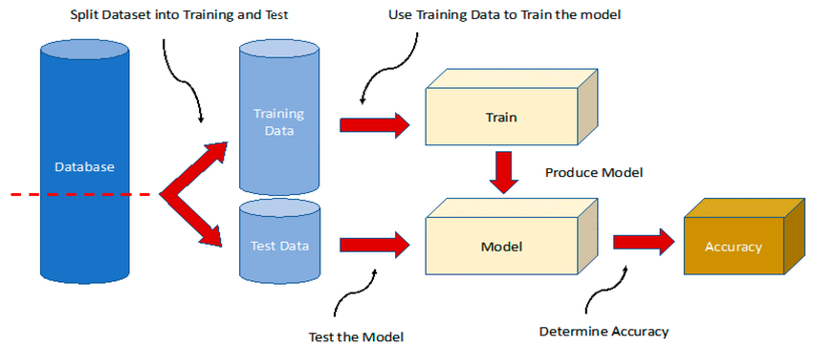
Splitting the data
Split the pre-processed dataset into train and test sets, for example 80% of the dataset as training set and 20% as test. Training set will be used for training the model for predicting the power plant . And after the training phase is complete, the testing set will be used for testing the model on its prediction ability when it is introduced with fresh data.

Slide 16
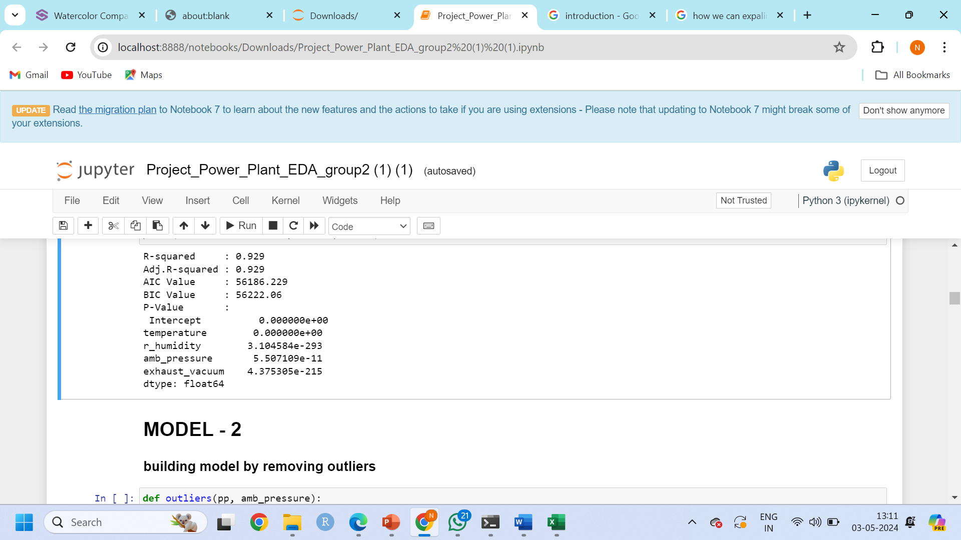
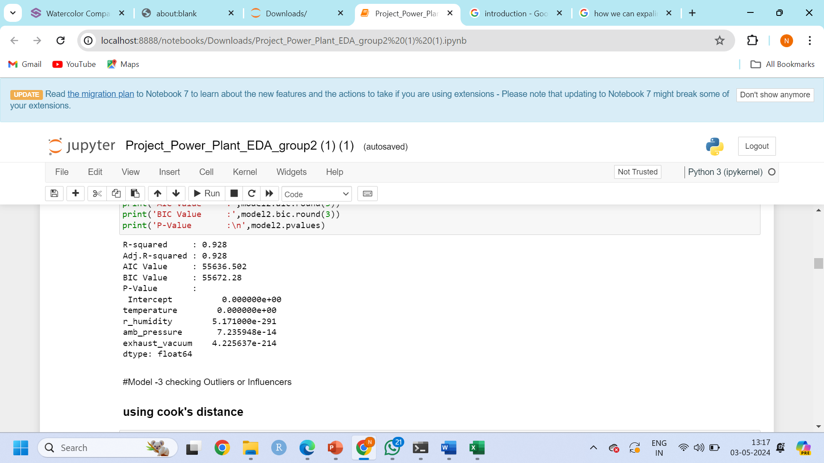
Model building
Building the model with outliers
Building the model by removing outliers
We build models with outliers and check the accuracy rate and after removing outliers there isn’t much change in the accuracy rate of the model.

Slide 17
Data analysis
1.What is Data Analysis? The science of analyzing raw data to make conclusions about that information.The data
analysis process includes setting goals,collecting,cleaning,and analyzing your data.
2.Where it can be used? Data analytics help a business optimize its performance, perform more efficiently,
maximize profit, or make more strategically-guided decisions.
3.What is Business intelligence (BI)? The technical infrastructure that collects, stores, and analyses company data.Business
intelligence (BI) is a set of strategies and technologies for analyzing business information and transforming it into actionable insights that inform strategic and tactical business decisions.
4.What are the four concepts of business intelligence?
*Data collection
*Data analysis
*Data visualization
*Decision-making
5.Model Building is an important phase of our Project cycle in converting our Data to Decision.
In our next slides we will review the various models that we experimented with and the decision we made.

Slide 18
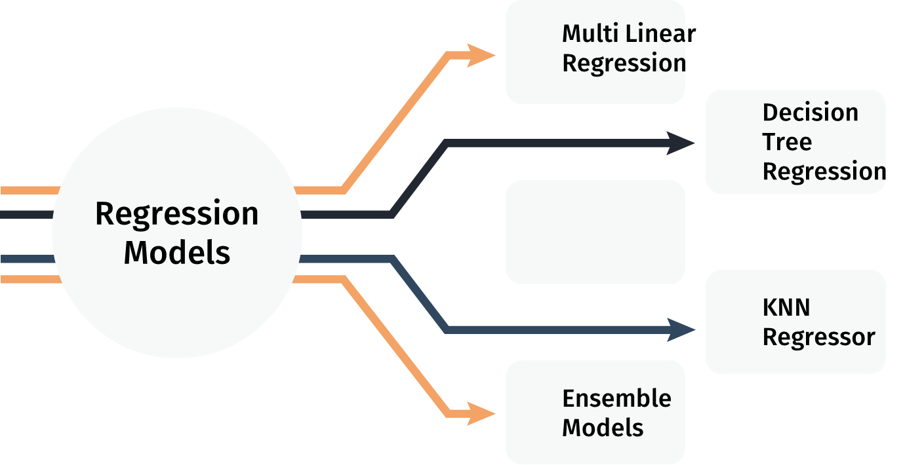

Various Machine Learning Models

Slide 19
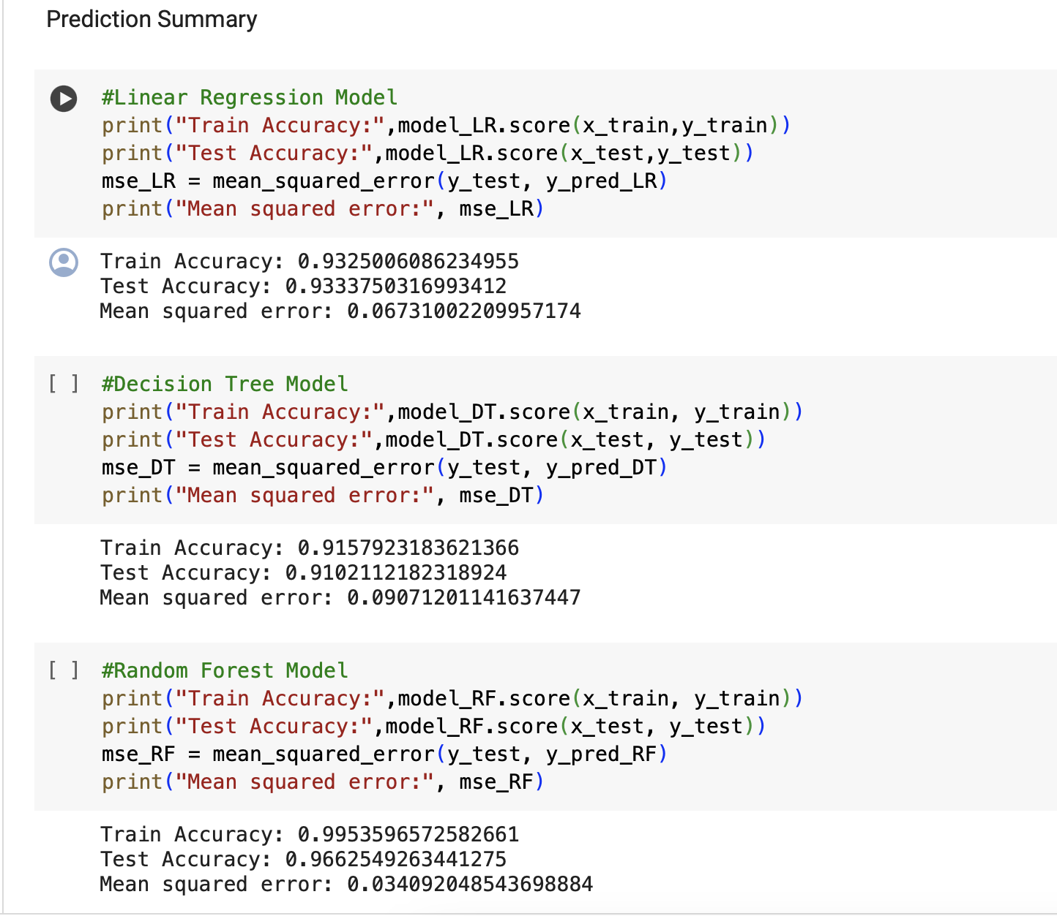
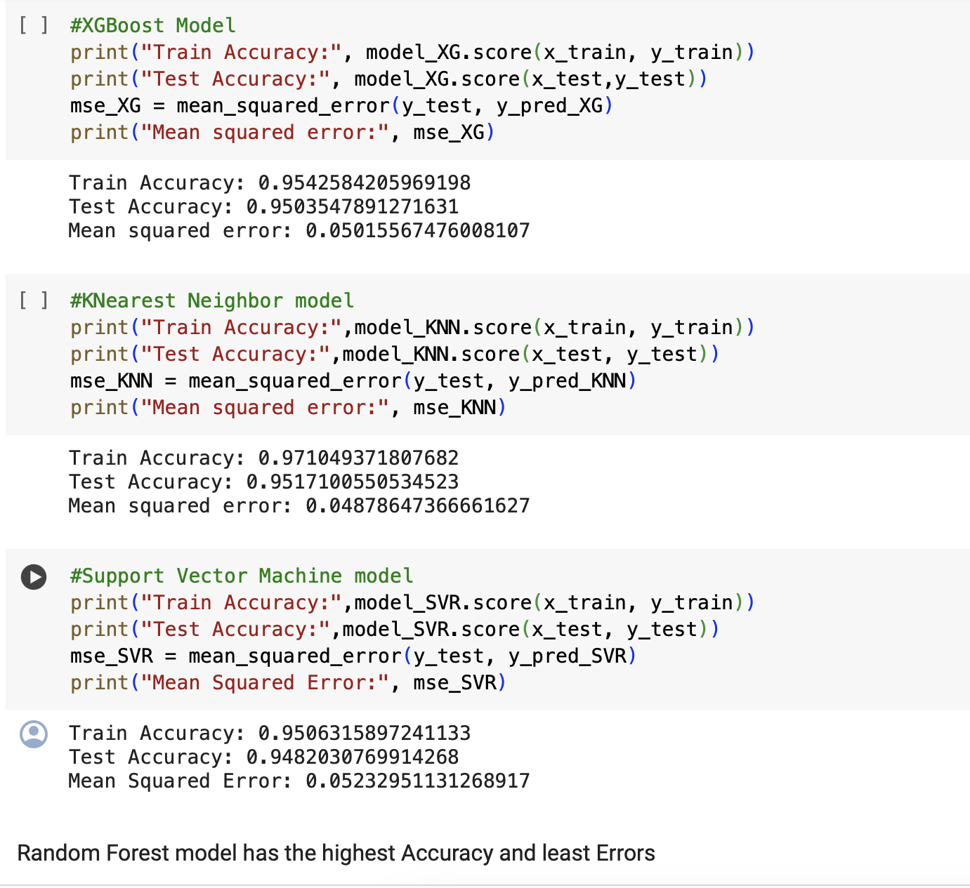
Model building

Slide 20
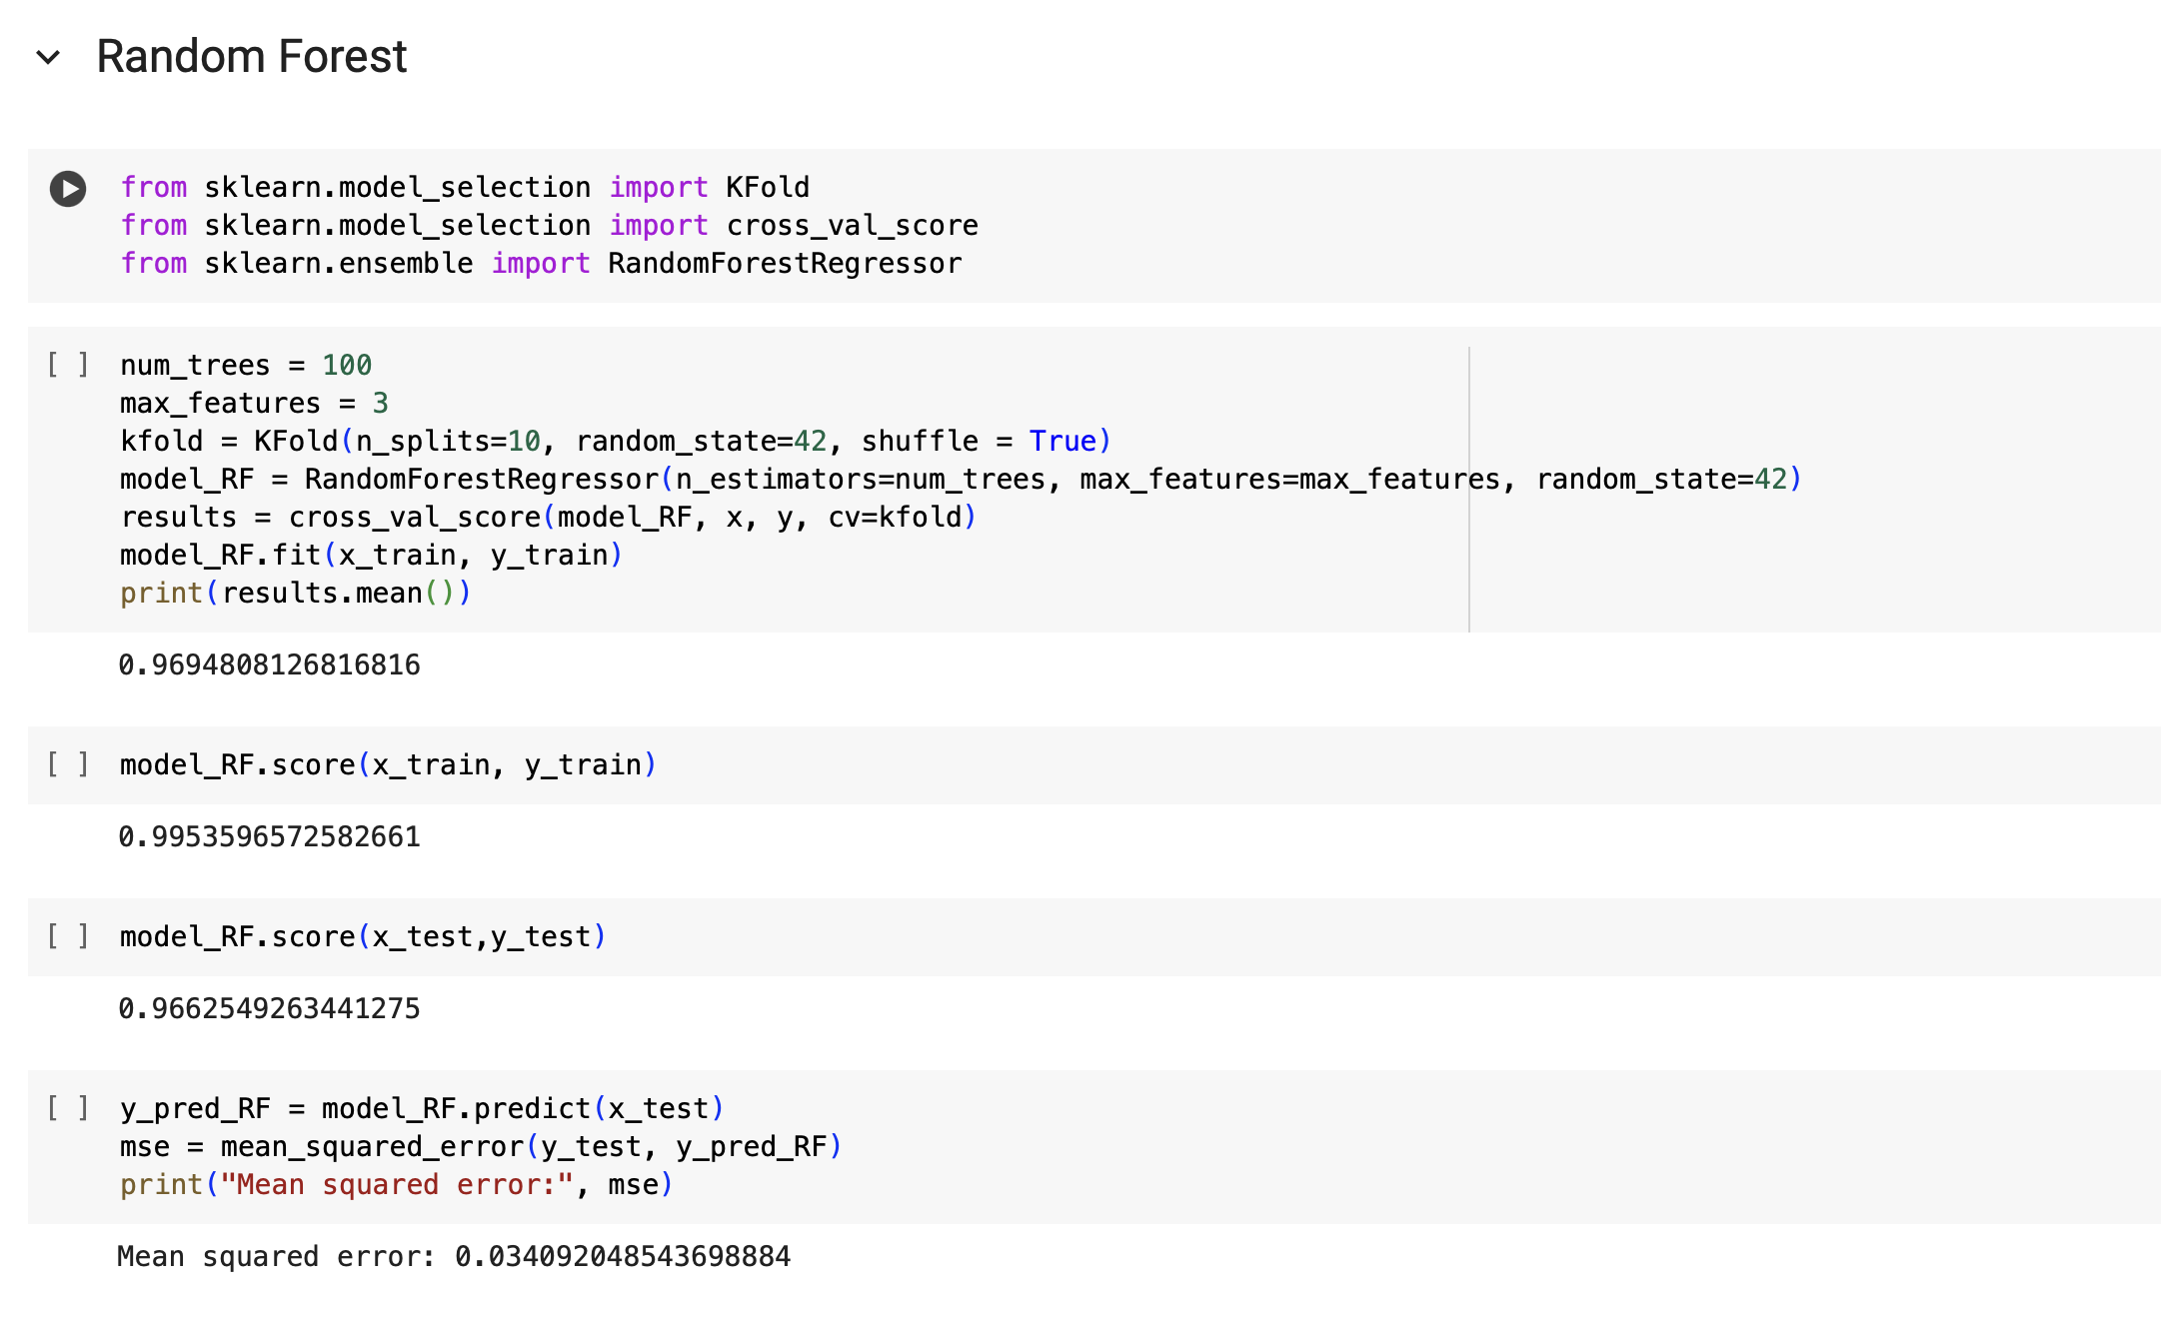
Best Model

Slide 21
Deployment Code
import pandas as pd
import numpy as np
import joblib
import streamlit as st
from sklearn.model_selection import train_test_split
from sklearn.ensemble import RandomForestRegressor
from sklearn.metrics import mean_squared_error
# Function to load the model
data = pd.read_csv("/Users/vidya/Downloads/Deployment(1)/Project/Copy of energy_production (1).csv")
# Separate features and target variable
X = data[['temperature', 'exhaust_vacuum', 'amb_pressure', 'r_humidity']]
y = data['energy_production']
# Split the dataset into train and test sets
X_train, X_test, y_train, y_test = train_test_split(X, y, test_size=0.2, random_state=42)
# Initialize Random Forest Regressor
rf_model = RandomForestRegressor(n_estimators=100, random_state=42)
# Train the model
rf_model.fit(X_train, y_train)
# Make predictions on the test set
predictions = rf_model.predict(X_test)
# Evaluate the model
mse = mean_squared_error(y_test, predictions)
print("Mean Squared Error:", mse)
# Save the model to disk
joblib.dump(rf_model, 'random_forest_model.pkl')
# Load the trained Random Forest model
model = joblib.load('random_forest_model.pkl')
# Function to make predictions
def predict_energy(model, temperature, exhaust_vacuum, amb_pressure, r_humidity):
prediction = model.predict([[temperature, exhaust_vacuum, amb_pressure, r_humidity]])
return prediction[0]
# Function to get user input
def get_user_input():
temperature = st.number_input('Temperature')
exhaust_vacuum = st.number_input('Exhaust Vacuum')
amb_pressure = st.number_input('Ambient Pressure')
r_humidity = st.number_input('Relative Humidity')
return temperature, exhaust_vacuum, amb_pressure, r_humidity
# Main code starts here
if __name__ == "__main__":
# Set title and sidebar header
st.title('Power Plant: Random Forest')
st.subheader('User Input Parameters')
# Get user input
Temperature, Exhaust_Vacuum, Ambient_Pressure, Relative_Humidity = get_user_input()
# Make prediction when the user clicks the button
if st.button('Predict'):
prediction = predict_energy(model, Temperature, Exhaust_Vacuum, Ambient_Pressure, Relative_Humidity)
st.subheader(f'Predicted Energy Output: {prediction:.2f} MW')

Slide 22
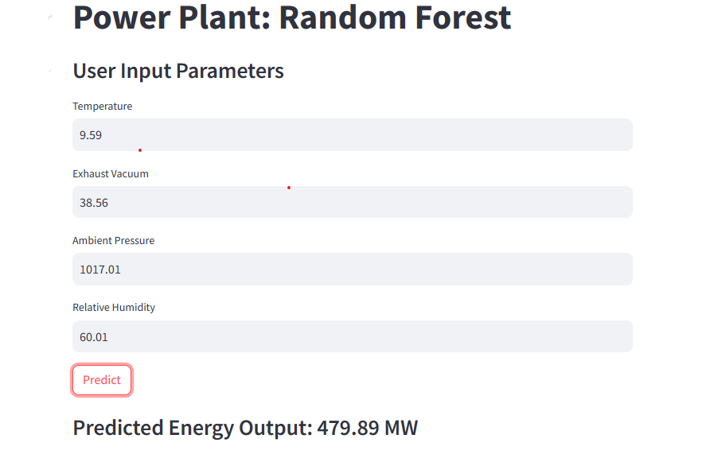

Screenshot of App to Predict Energy Production

Slide 23
Thank you
Nida Fatima Md Irfan: nidasayyed36017@gmail.com gowdas107@gmail.com
Ms. Pooja U B : ppoojaubasavaraj@gmail.comjaubasavaraj@gmail.com
Mrs. Mamatha R : gaganvihari2021@gmail.com
Ms. Thillaikarasi R : thillaiglittu@gmail.com
Ms VIDYA SUNDARAN : vidi89s@gmail.com
@gmail.comidasayyed36017@gmail.com

